Slide 1
Dawg Deals
The Design Process: From Start to Finish
Brooks Lobe INFO 360 C – Fall 2015

Slide 2
Introduction
This process book details the different stages of the design process that took Dawg Deals from an idea to an app ready for development.
Included is a commentary on my contributions to the process, as well as visuals and descriptions of the different stages of the process.

Slide 3


Looking for a Problem
After hearing that we would be working to implement a solution to help make the lives of college students easier, I immediately thought of designing an app that would provide discounts on food. I aimed to create a service that combined the accessibility of a couponing app like Groupon, and the purpose of the UW Bookstore’s quarterly coupon handbook.
Defining the Problem

Slide 4
Interviews
Do you prefer an app for students only?
How do you buy food: Grocery Stores or Restaurants?
Do you care about how much you spend on food?
Guidance for Design
Going into our first interviews to gain a better understanding of our context, I already had a sense of what I wanted to design. My idea (a gamified couponing app for food) was rather specific due to being so early on in the design process.
Peer interviews allowed me to gain insight into what values and priorities my potential users held, shaping my work later on in the design process.
Defining the Problem

Slide 5
Defining the Information Problem
Based on the peer interviews, it appeared that the idea of a gamified couponing app for restaurants was both feasible to design and interesting for users.
However, it became apparent that I had developed a solution without a specific problem in mind. People inherently want to save money (more specifically, money on food), but I had to prove why someone would need my solution.
I had to pull from a variety of sources to better state the problem at hand before continuing on to design a solution.
Interview Feedback
My Ideas
Information Problem
Teammate’s Ideas
Teammate’s Ideas
Defining the Problem

Slide 6
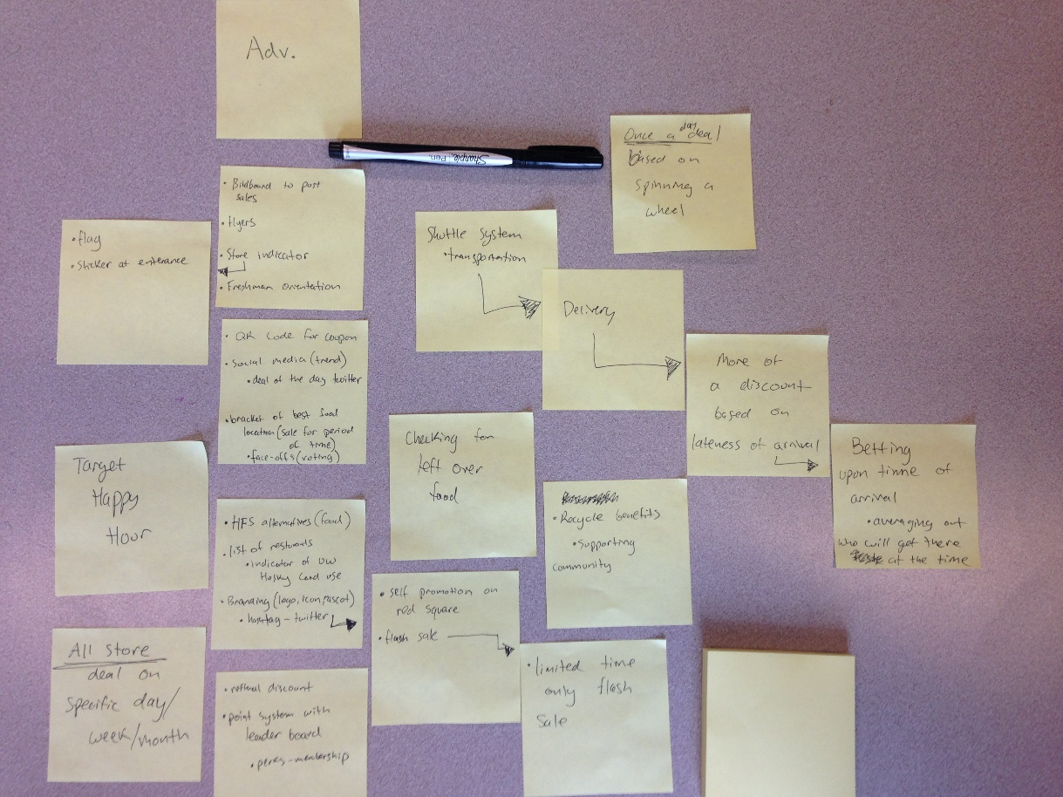
Brainstorming
In order to make sure that we were considering the whole host of options available to us, we brainstormed a diverse set of potential designs.
Everything was on the table, from the super-practical to the ludicrous.
Divergent Thinking

Slide 7
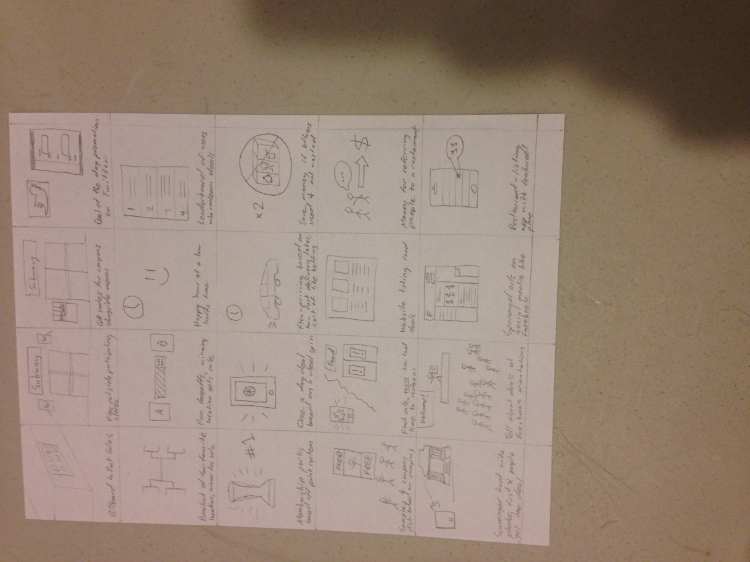
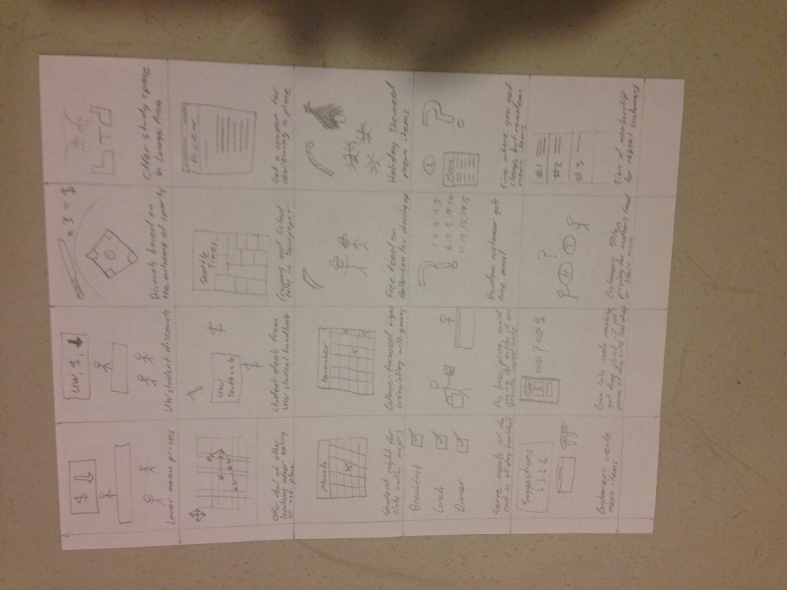
40 Ideas
Expanding upon the previous exercise, we continued to think outwardly about design possibilities.
I came up with 40 different designs to solve our problem (high food costs for college students) which varied in complexity, medium, and originality.
Divergent Thinking

Slide 8
A Conflict of Interests
Cool Factor
Usefulness for client
Feasibility to produce
After generating a massive amount of ideas, we had to decide which solution we were going to pursue.
To expedite this process, we compared the different proposed solutions using a multi-dimensional value axis.
This system helped to eliminate ideas that didn’t align with our target values.
Convergent Thinking

Slide 9
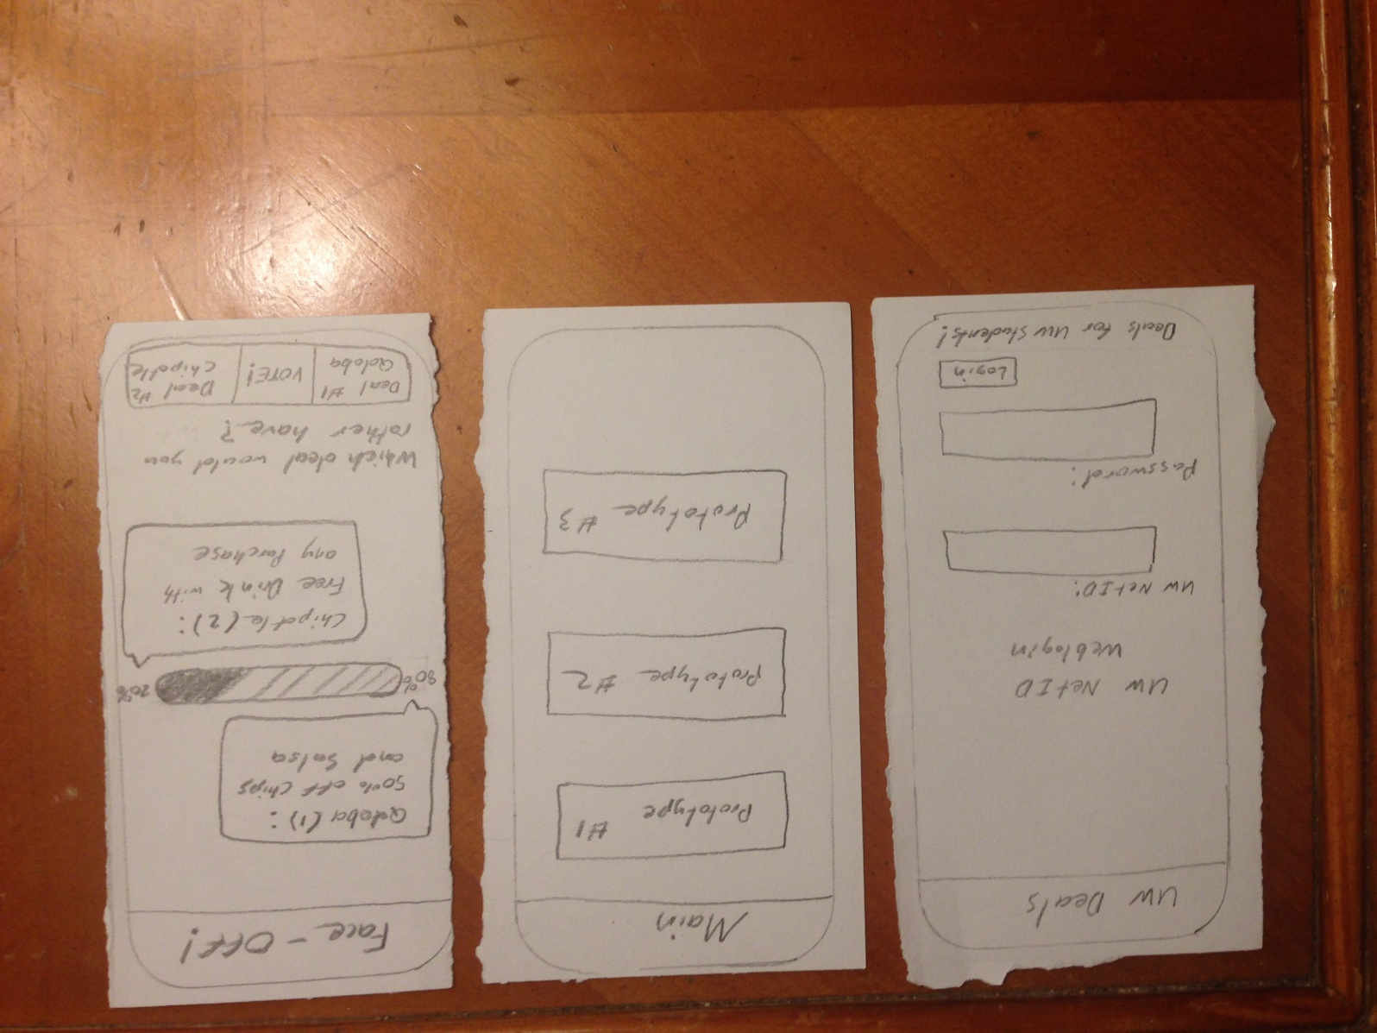
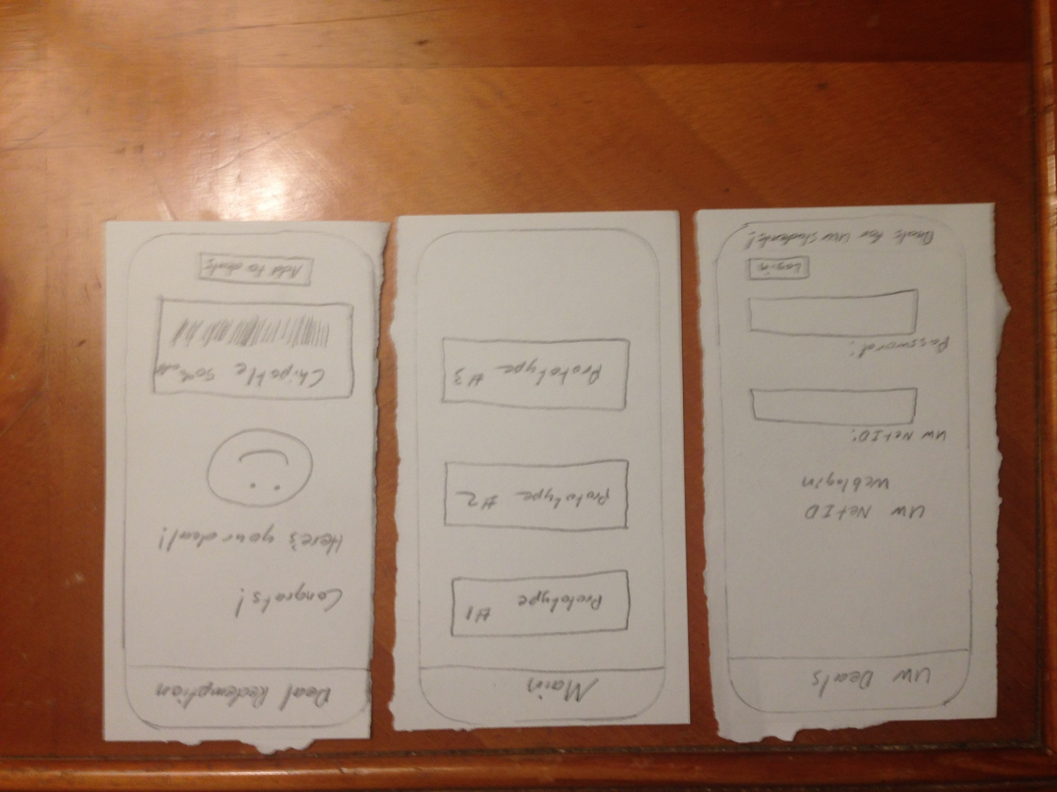
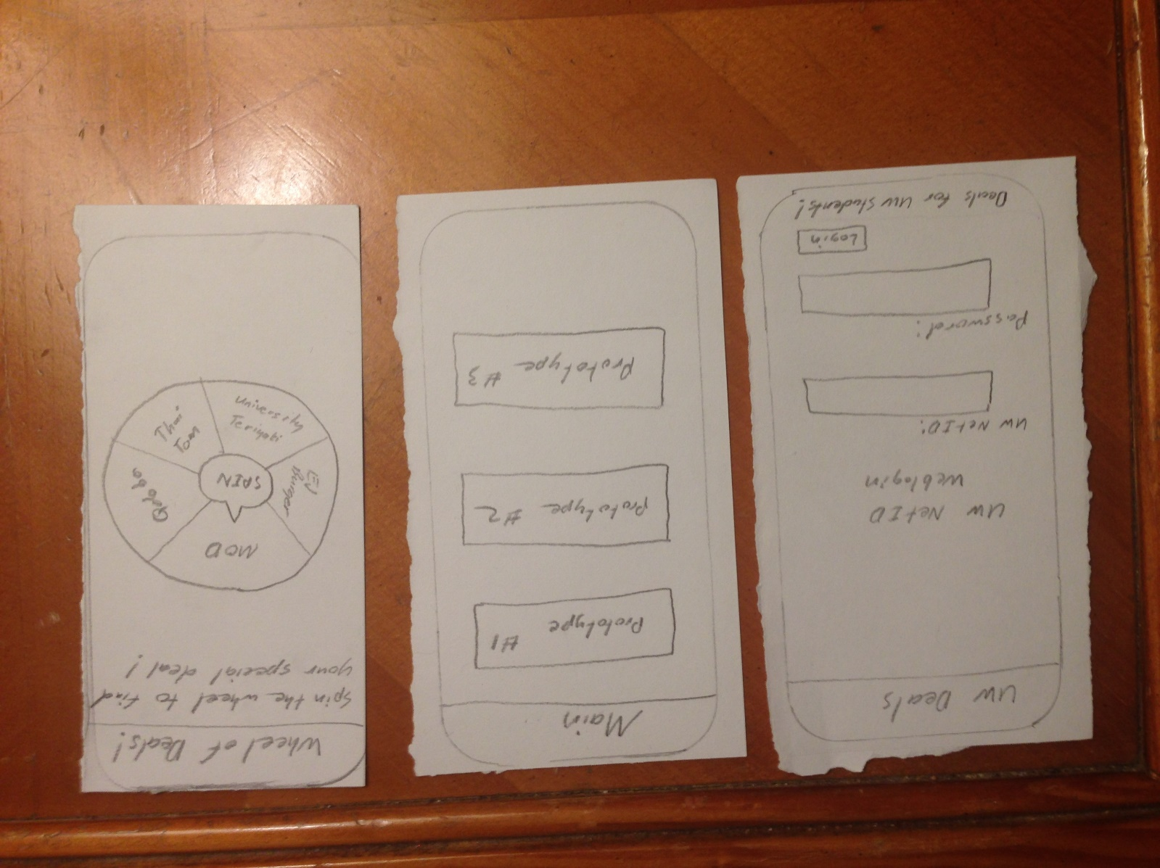
Prototypes of the Top 3 Ideas
We settled on our top solutions and sketched out how they might look if produced.
Convergent Thinking

Slide 10
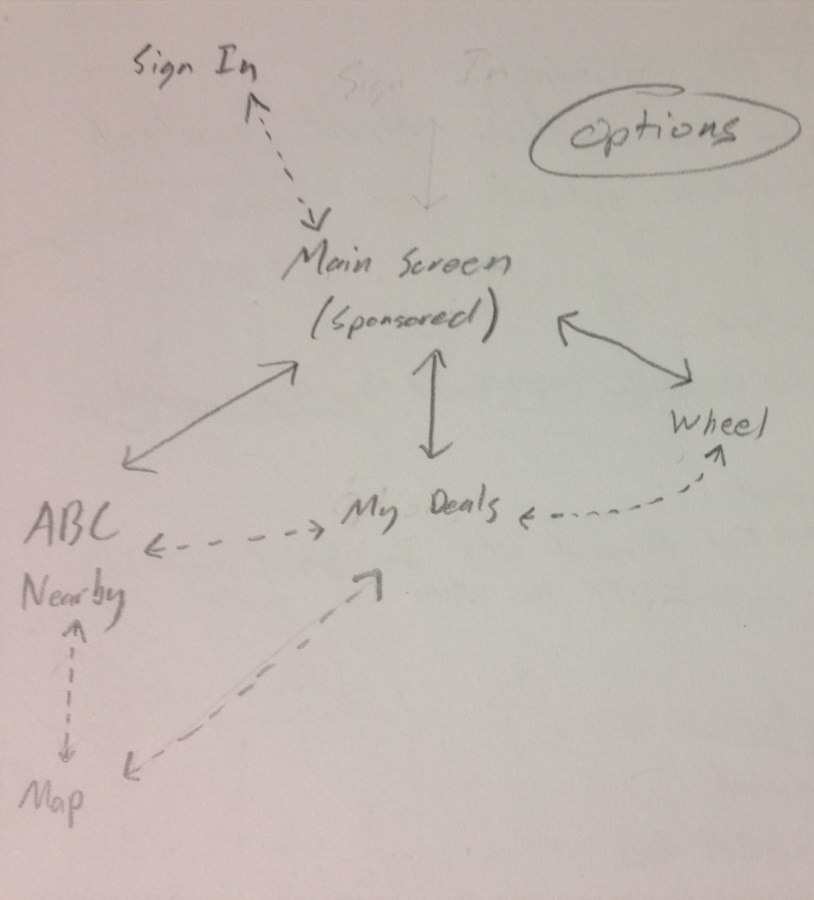
Feedback from Critiques
Once we had received critique on our mockups, our group thought that we could probably combine the three solutions into one app, since they were relatively simple and they all received positive feedback.
I diagramed the information flow of the app between its different screens and came to the conclusion that we had to settle on one solution. By combining the ideas, we would lose more in accessibility than what we would gain in overall functionality.
Pictured is the information flow for the solution that we ultimately selected.
Convergent Thinking

Slide 11
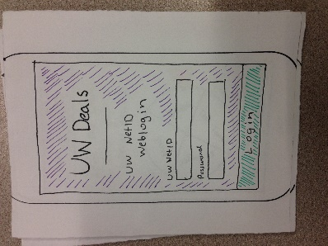
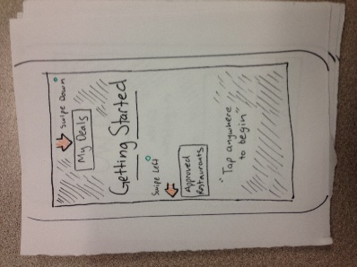
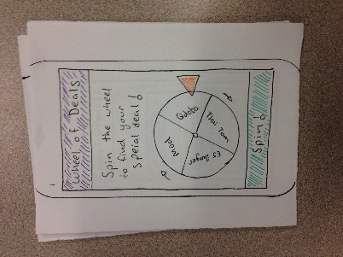
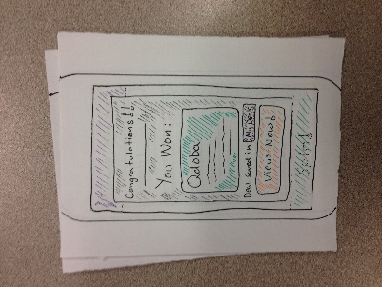
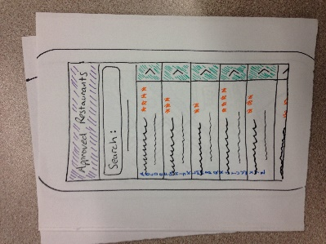
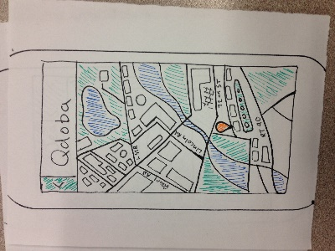
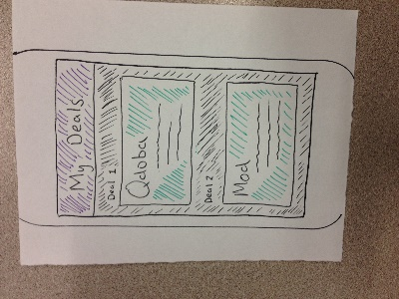
Implementing the Solution
Based on the information flow of the app, I participated in designing the user interaction of the app through the various buttons and other inputs on each screen.
Convergent Thinking

Slide 12
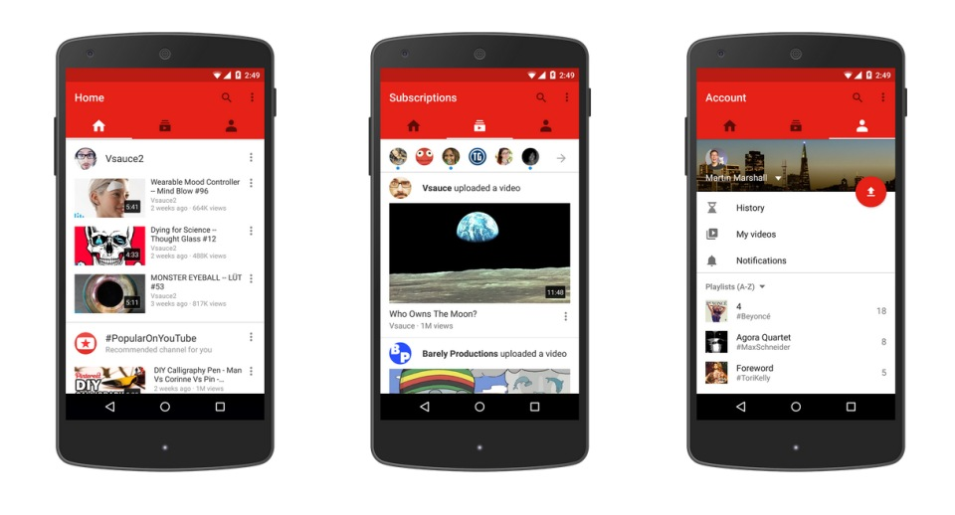
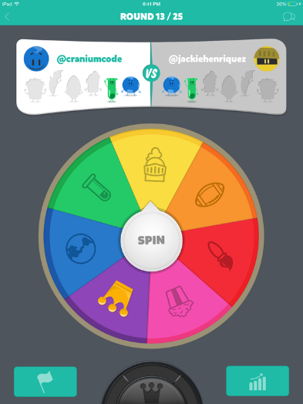
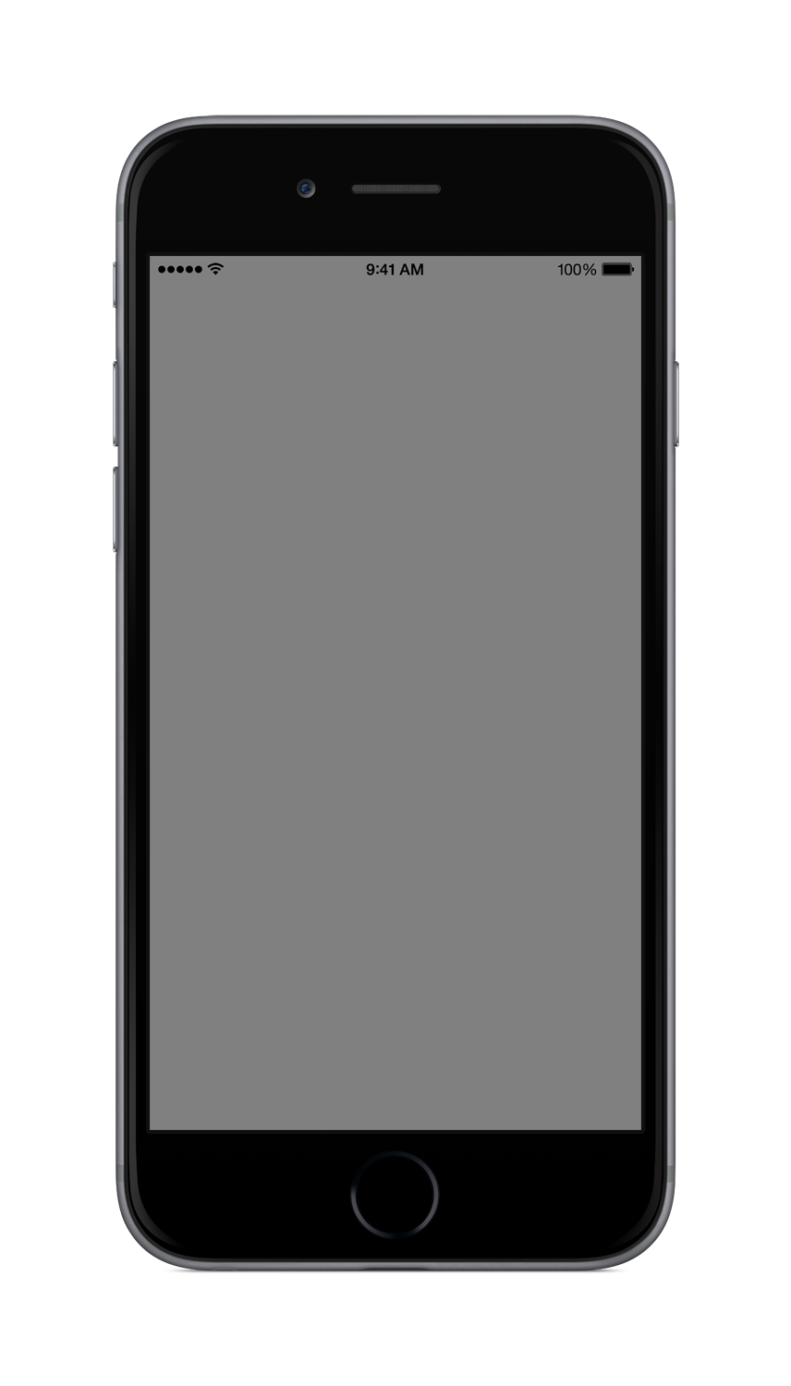

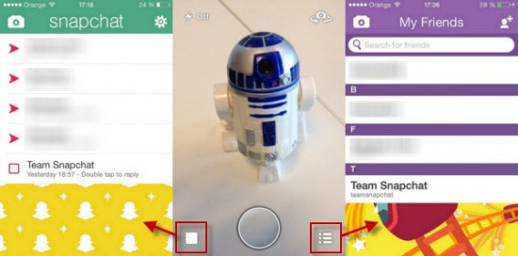
Inspiration from Existing Apps
Before producing a polished looking app design, I gleaned inspiration from the layouts of a few popular apps.
YouTube
Trivia Crack
Developing the Prototype
Snapchat

Slide 13

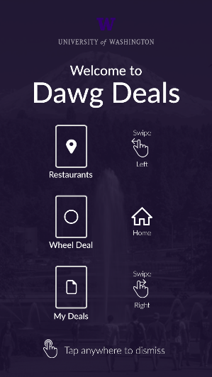
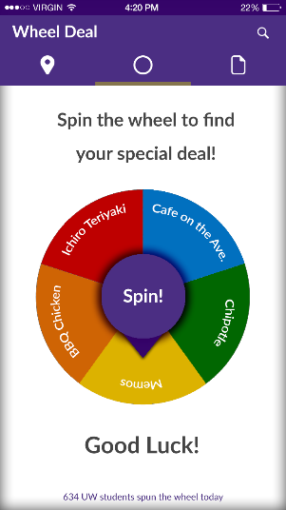
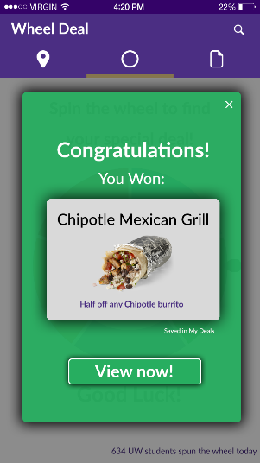
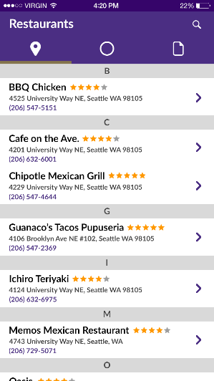
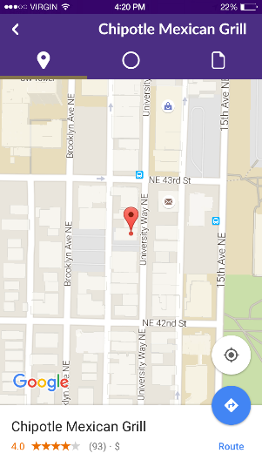
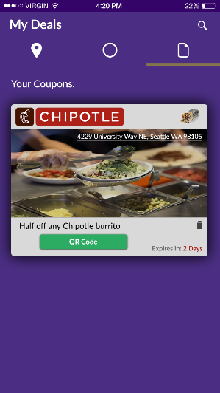
Refining the Solution
Based on feedback provided for our low-fidelity prototype and my own opinions on app design, I helped guide the group member in charge of graphics work to produce a high-fidelity prototype.
Developing the Prototype

Slide 14
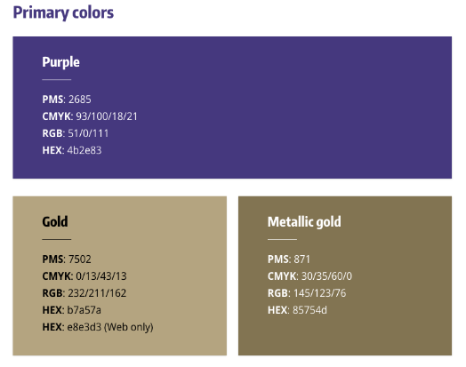
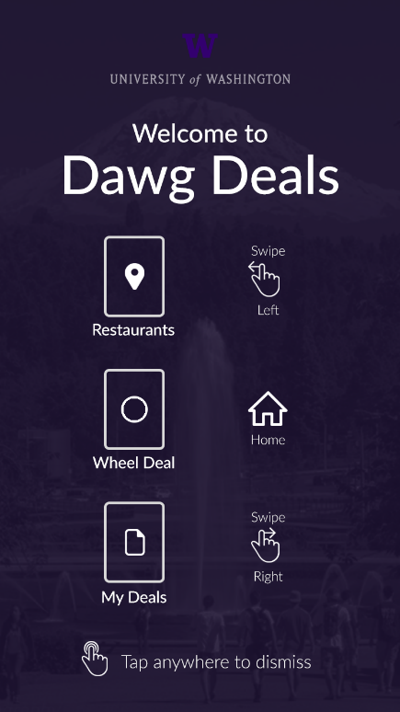
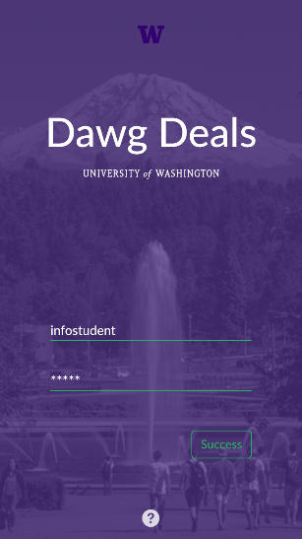

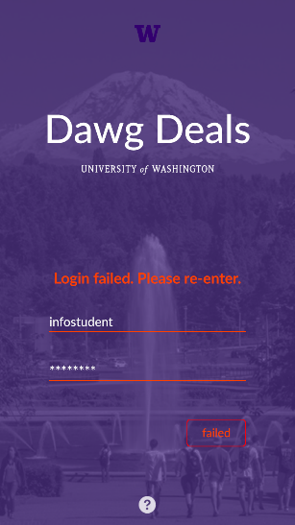
Attention to Small Details
We touched up our app by checking to make sure we adhered to a variety of user interface design heuristics.
In this, I found a lot of places where our app could deliver a better user experience. This mainly consisted of elements that aren’t overly prominent but assist the user without their knowing.
Developing the Prototype

Slide 15
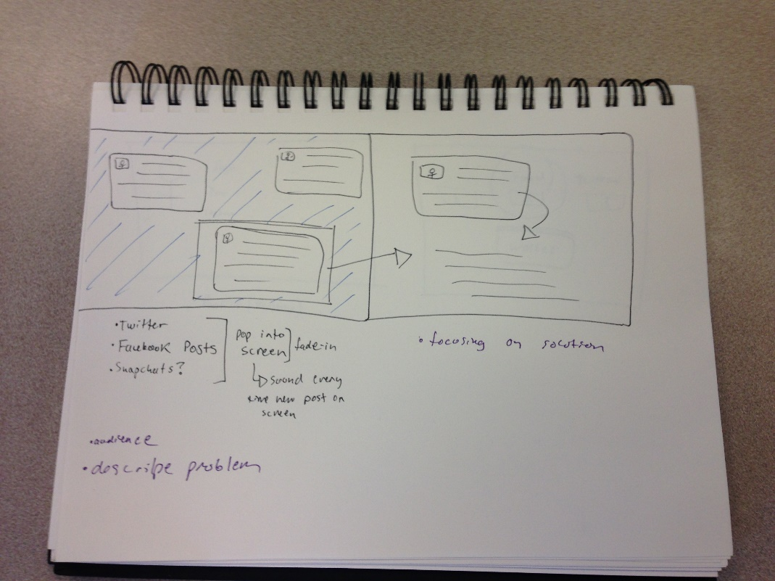
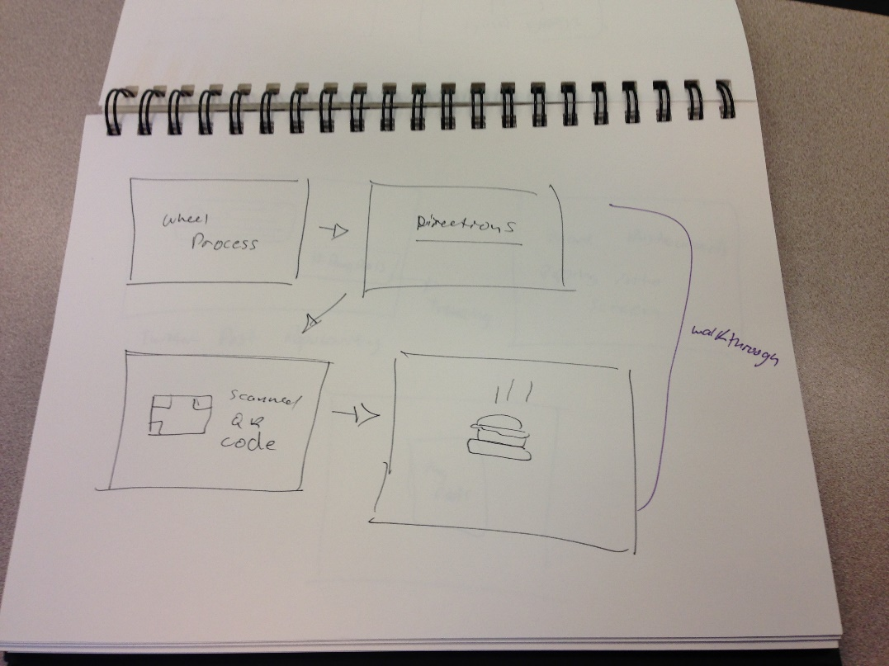
Storyboarding
To share our solution with others, we made a video to showcase our app.
Sharing with the World
I helped come up with a general storyboard for the video.

Slide 16
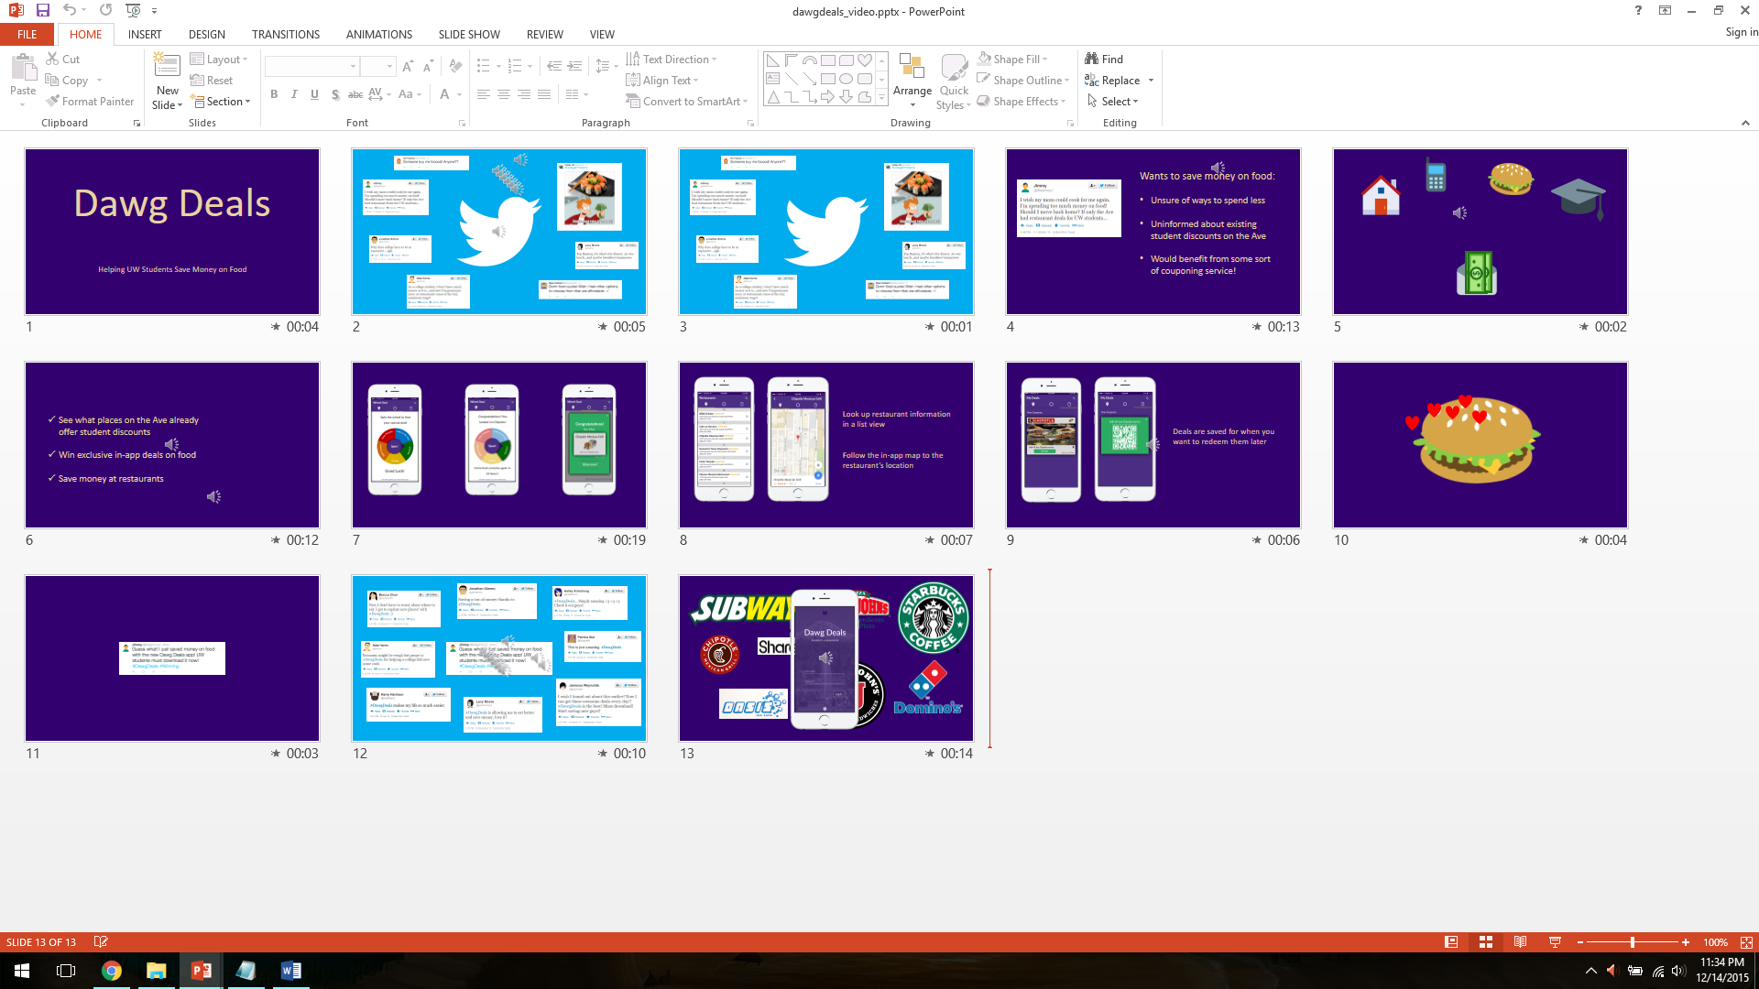
Creating the Video
Later, I used PowerPoint slides to match the storyboard we made.
My team supplemented me with graphics that I didn’t already have from the high-fidelity prototype or that I made myself.
Sharing with the World

Slide 17
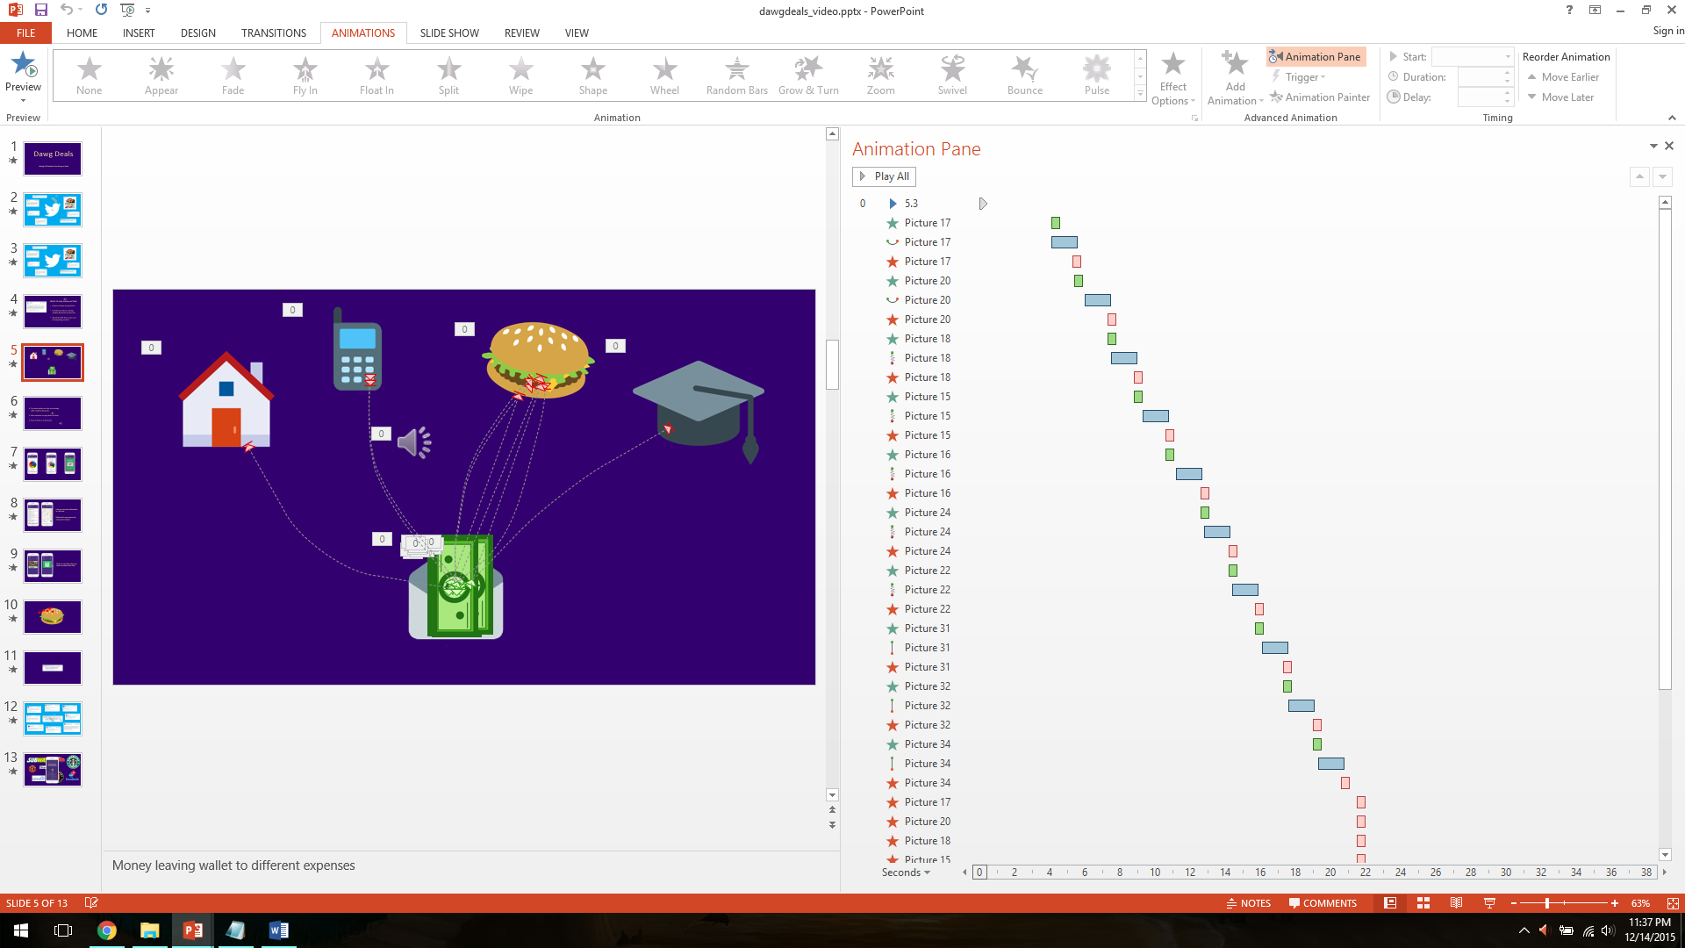
Narration and Editing
I also did all the editing and narration for the video, in PowerPoint as well.
Since PowerPoint is always used for simple presentations, I was blown away by the range of functionality that the program offers!
Sharing with the World

Slide 18
Conclusion
In this design process, I experienced the first time that I had to seriously use divergent thinking. While I easily thought of a service that would prove to succeed, I had to backtrack and frame its usefulness by identifying the specific issue that it solved. Finally, I got solid practice with user interfaces and was even able to refresh my skills at creating and editing videos.

